Slide 1
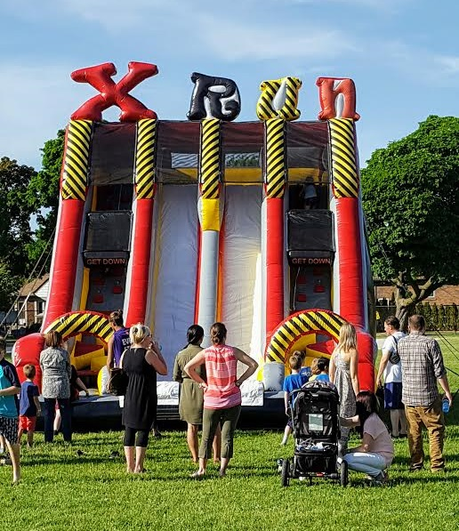
Planning a Successful School Event
We want you to succeed!!!

Slide 2
Benefits of school fun fairs
Raising funds for the school
Enhance school spirit
with community involvement, build goodwill between school and surrounding community
Enhance leadership qualities in students
Upon completion of a successful event, students have a strong sense of accomplishment
Provides invaluable interaction between staff and students

Slide 3
Choose a date……and a rain date
Remember, most schools will host their fun fair on Thursday or Friday. Selecting another day of the week may be slightly less expensive.
Day before a long weekend or PA day?
If it looks like rain can you go indoors?
Event times. Allow for set-up, event and tear down

Slide 4
Choose a supplier
Be diligent in choosing a company to work with:
*Check with your principal or school board office for approved vendors
*Make sure all licensing and insurance documents are up to date
*Get referrals
*obtain a quote with “wish list” items
*upon confirmation, Meet with company representatives (no charge)

Slide 5
Choose a supplier 2
*Obtain a copy of the TSSA (Technical Standards and Safety Authority) operator’s License
*Obtain copies of amusement device permits. Each inflatable has it’s own device permit number. Many companies have a tssa operator’s license, however, they may not have, or only obtain permits for a few items.
*obtain a copy of the liability insurance policy. Request that your school be added as additional insured and have a copy sent to you.

Slide 6
Choose a supplier 3
*meet with the owner or event manager:
Ask about staff training, safety policies, equipment, event procedures, references
*Ask about staffing at events. Many companies will do a “drop and run” to cut costs, leaving school volunteers and students to set up. Not only is this unsafe, it is against the guidelines of the tssa and therefore classified as illegal. A reputable company will set-up, supervise and tear down their own equipment.

Slide 7
Choose your equipment
How many people will attend your event?
Age breakdown?
Theme vs no theme
Get input from your supplier
Fundraiser vs fun day
School only vs community involvement
Budget!!!! sponsorships

Slide 8
Site inspection
Meet with your supplier’s event specialist or manager to go over your equipment’s location, access to your field, timing, any special instructions (sandbags only, sprinkler locations, etc.)
Get a site plan!! Make sure you receive a copy well in advance of your event.
This is the time to discuss a rain plan. What will fit indoors? Can you substitute items? Power?

Slide 9
volunteers
Mature, responsible and attentive
Able to commit to the full event or have replacements
Must be trained if assisting with tssa licensed items
Never expected to assist in the set-up or teardown of equipment
High school students need volunteer hours!!
Use a sign in/sign out sheet

Slide 10
Things to remember
Pre-sell wristbands or tickets for your event
Make sure parent consent forms are signed prior to event day
Advertise your event! Photos of the equipment helps to generate excitement.
Your supplier is a valuable resource, use their knowledge to increase yours
The day will be hectic, be prepared
Delegate, delegate, delegate
Have fun!!!

